Slide 1
Global Review of Megafauna Interactions with Marine Aquaculture Farms
Gretchen E. Bath,¹ Carol Price,² Kenneth L. Riley,³ James A. Morris, Jr.⁴
¹CSS, Inc under contract to NOAA NCCOS
²North Carolina Aquariums/NC State University
³NOAA NMFS Office of Aquaculture
⁴NOAA/NOS, National Centers for Coastal Ocean Science

Slide 2
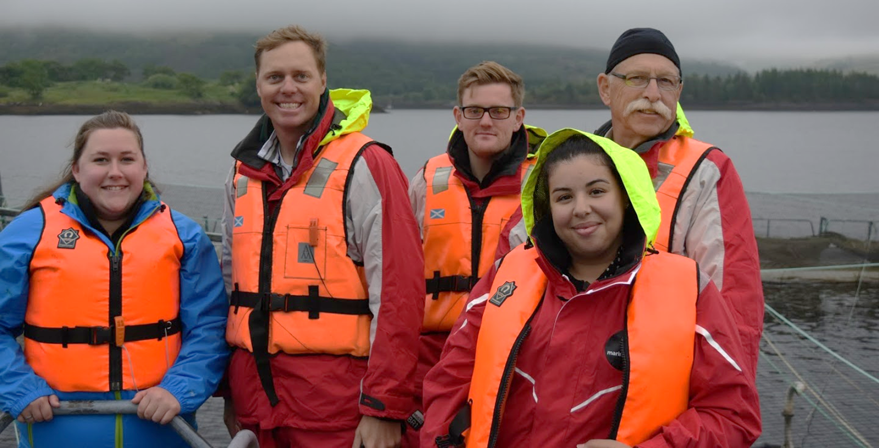
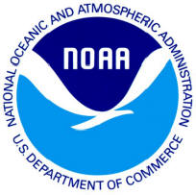
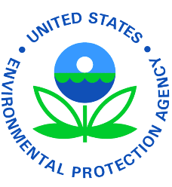
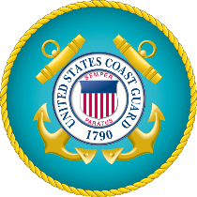
Coastal Manager Support
We have developed a blended research and services portfolio. Services inform science; science inform services.
Types of support Spatial planning Environmental modeling Environmental science advice
Engineering review
Customers - All federal and state agencies

Slide 3
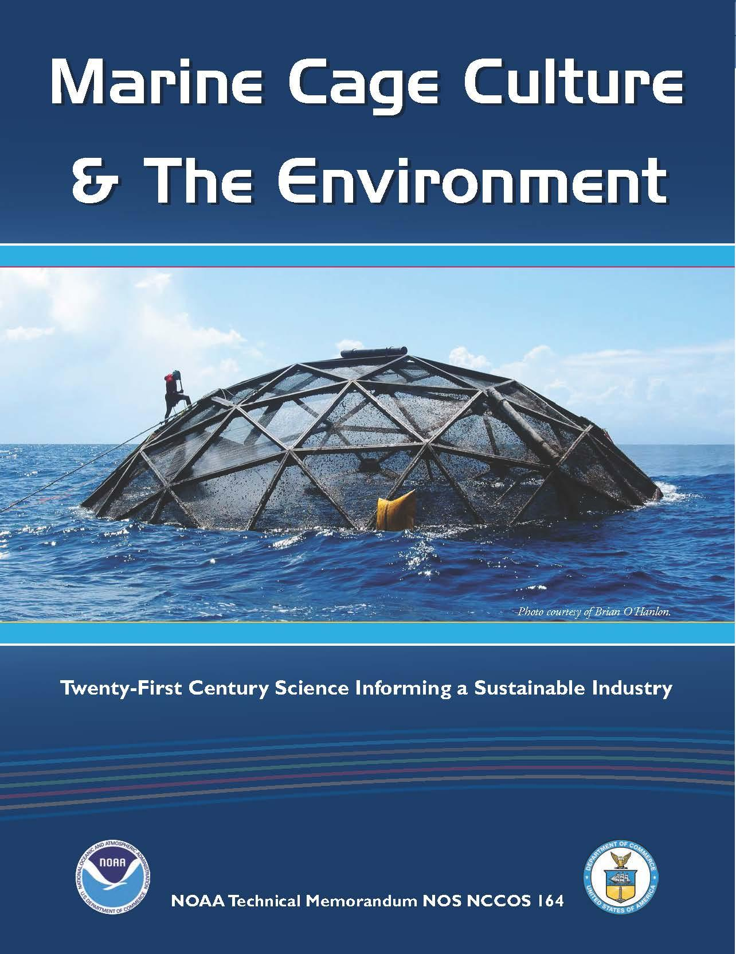
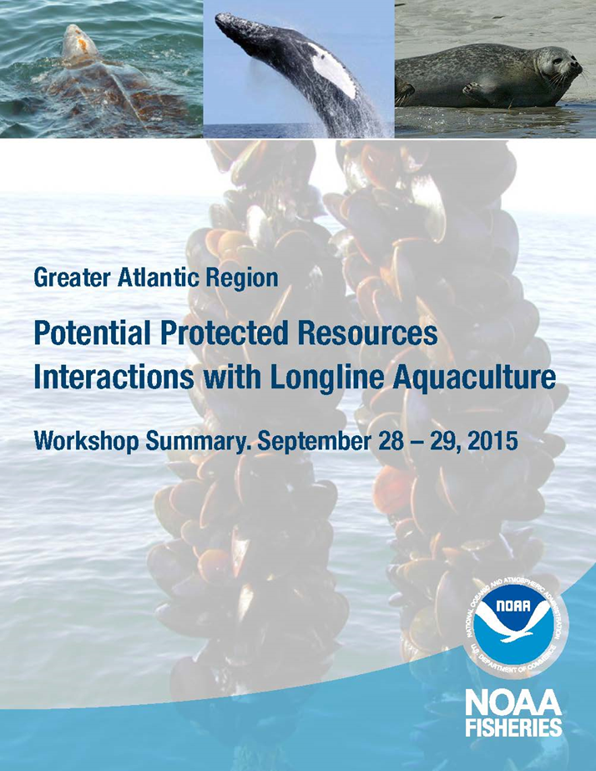
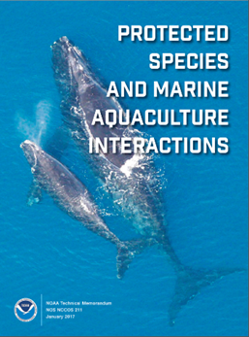
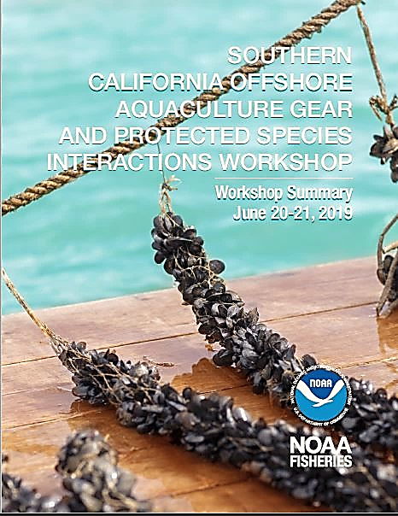
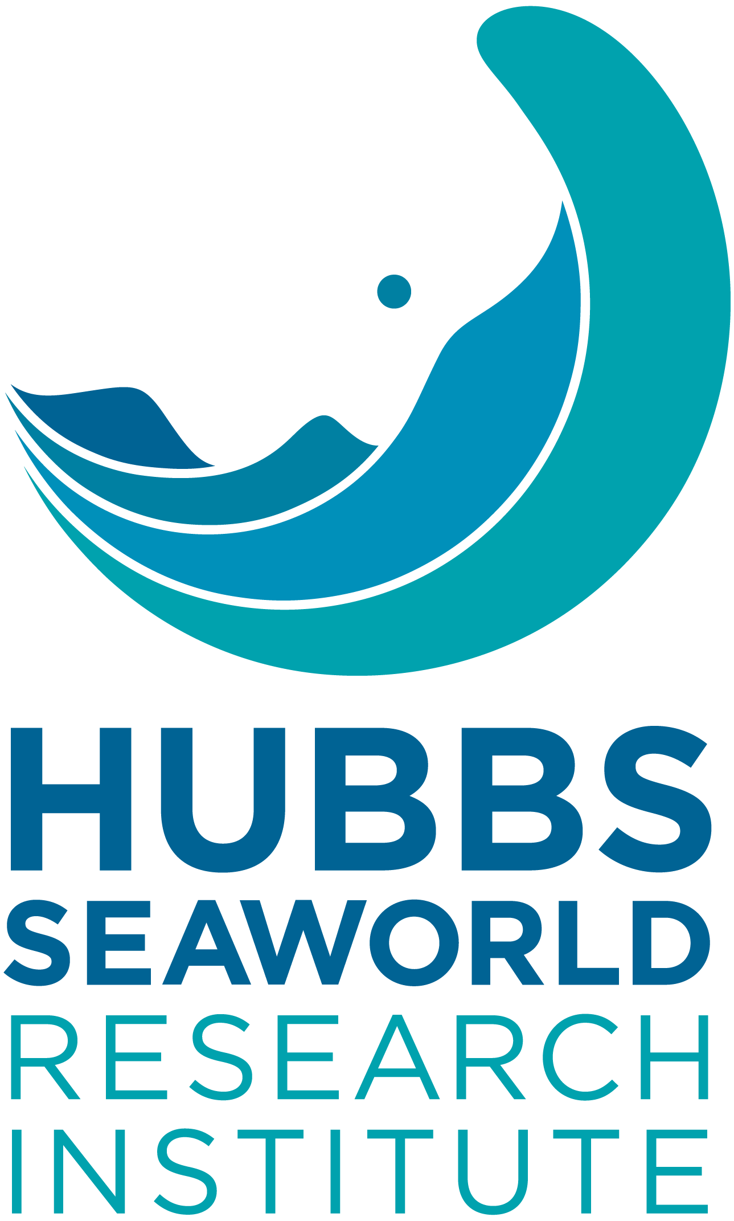
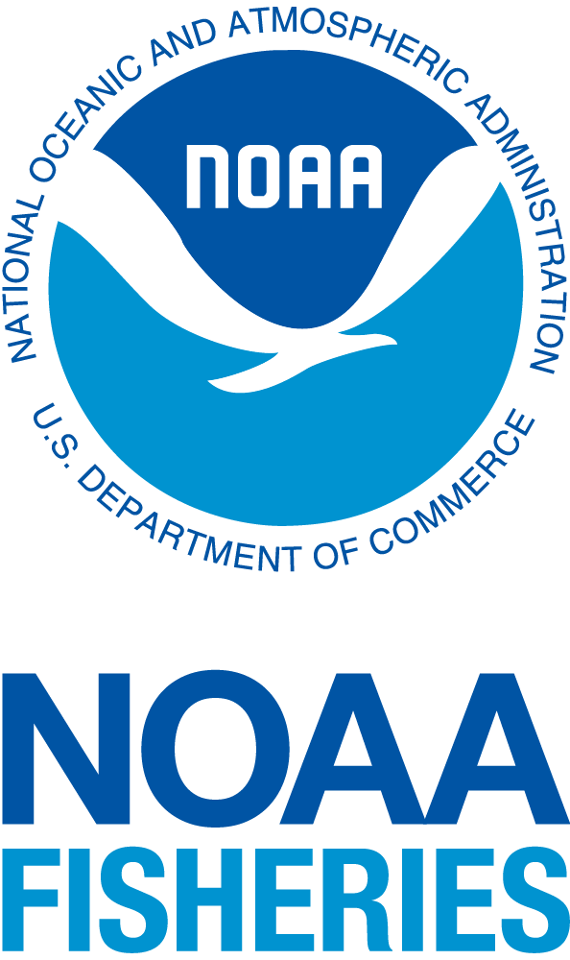
Previous studies and workshops
December 2013
September 2015
January 2017
June 2019
SOUTHERN
CALIFORNIA OFFSHORE AQUACULTURE GEAR
AND PROTECTED SPECIES INTERACTIONS WORKSHOP
Workshop Summary
June 20-21, 2019
West Coast Open-Ocean Aquafarms: The Science of Animal-Gear Interactions & Pro-Active Engineering Solutions
Price and Morris 2013
Price et al. 2017
Aquaculture Entanglement Workshops
La Jolla, California
Diane Windham
Ann Bowles

Slide 4
Primary questions
What protected species and marine aquaculture interactions have been documented globally?
How can we anticipate and proactively mitigate risk through informed siting, gear design, and engineering?
How should we monitor farms to collect data and avoid negative impacts to vulnerable species?

Slide 5
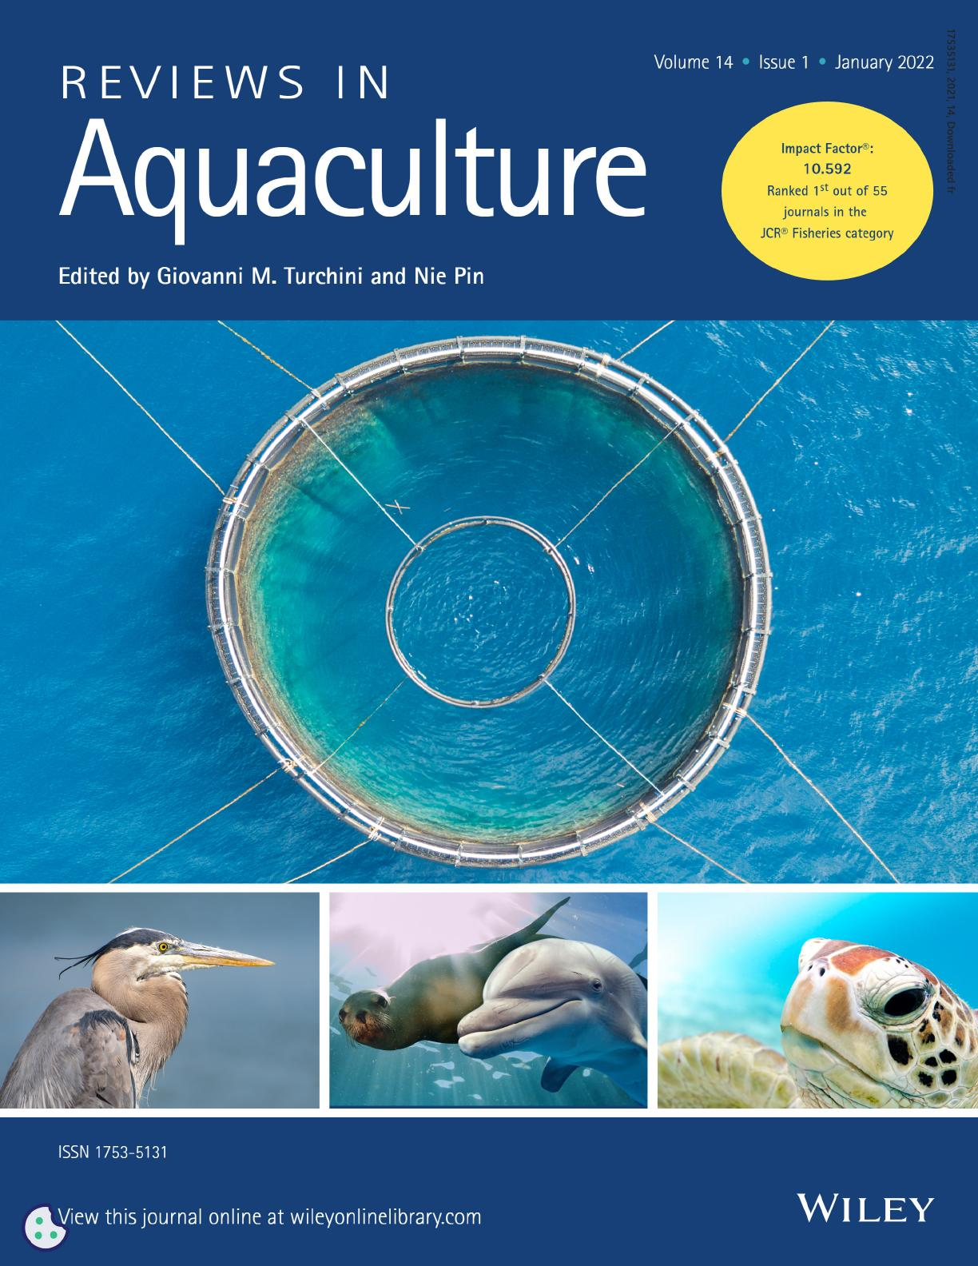
REVIEW
A global review of protected species interactions with marine aquaculture
Gretchen E. Bath | Carol A. Price | Kenneth L. Riley | James A. Morris, Jr.
Reviews in Aquaculture - forthcoming 2023

Slide 6
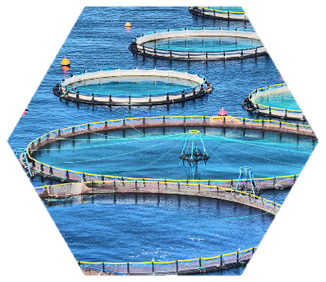
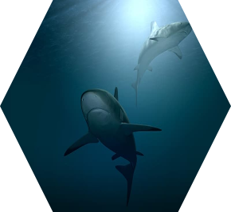
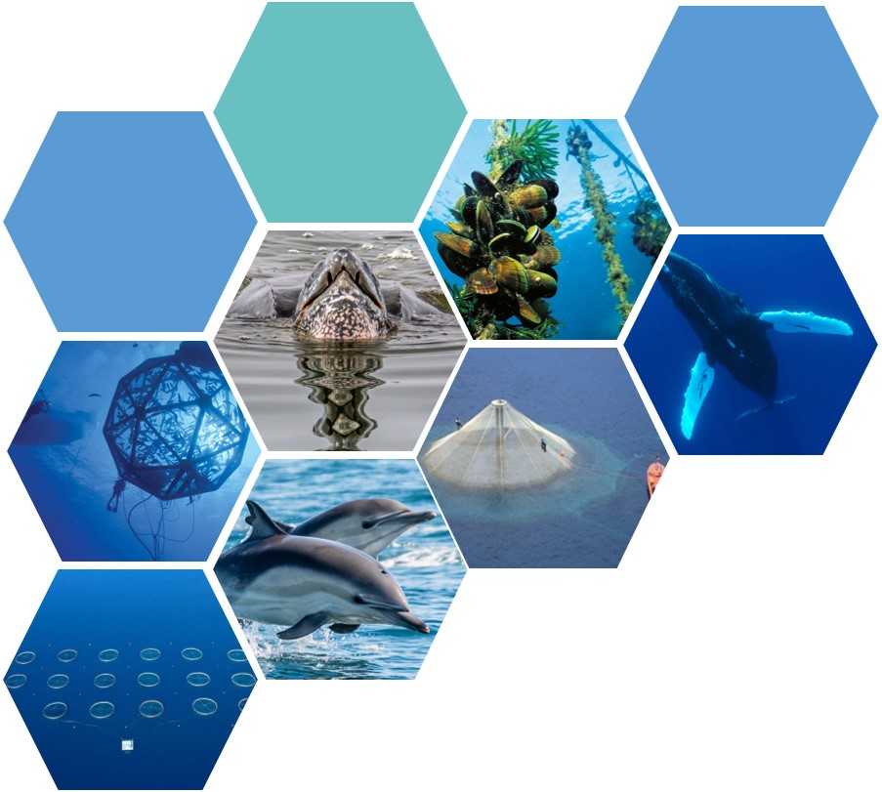
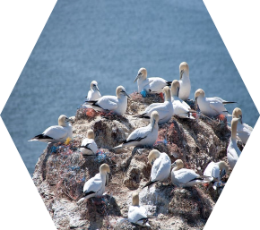
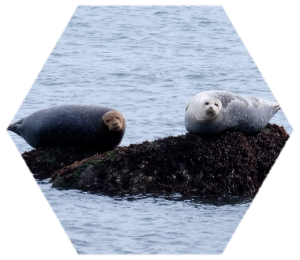
A GLOBAL REVIEW OF PROTECTED SPECIES INTERACTIONS WITH MARINE AQUACULTURE
INTRODUCTION
MARINE AQUACULTURE
Longline mussel aquaculture
Finfish aquaculture
PROTECTED SPECIES AND MARINE AQUACULTURE
Marine mammals
Habitat modification, exclusion, or competition for space
Entanglement
Underwater noise disturbances
Vessel traffic
Attraction to artificial lighting
Risk management and depredation mitigation
Sea turtles
Entanglement
Underwater noise disturbance
Vessel traffic
Risk management
Seabirds
Habitat modification, attraction, or exclusion
Entanglement
Risk management
Sharks
Shark presence at offshore farms
Threats to gear and workers
Dietary shift
Risk management
Marine Debris
CONCLUDING REMARKS
INSERT IMAGE

Slide 7
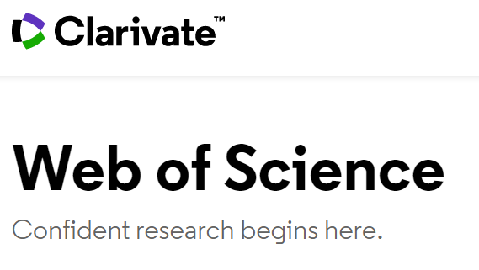
Methods
Information sources
Keyword searches in:
Web of Science
ProQuest ASFA
Elsevier Science Direct
JSTOR
Google Scholar
Requests from gov. agencies, professional contacts, and searching through authoritative sources
scientific papers
government reports
online databases
international commissions and conventions
industry organization documents
certification program requirements, published data, reports
company sustainability and investor reports
newspaper articles
unpublished data from operational commercial farms
regional fishery management organizations

Slide 8
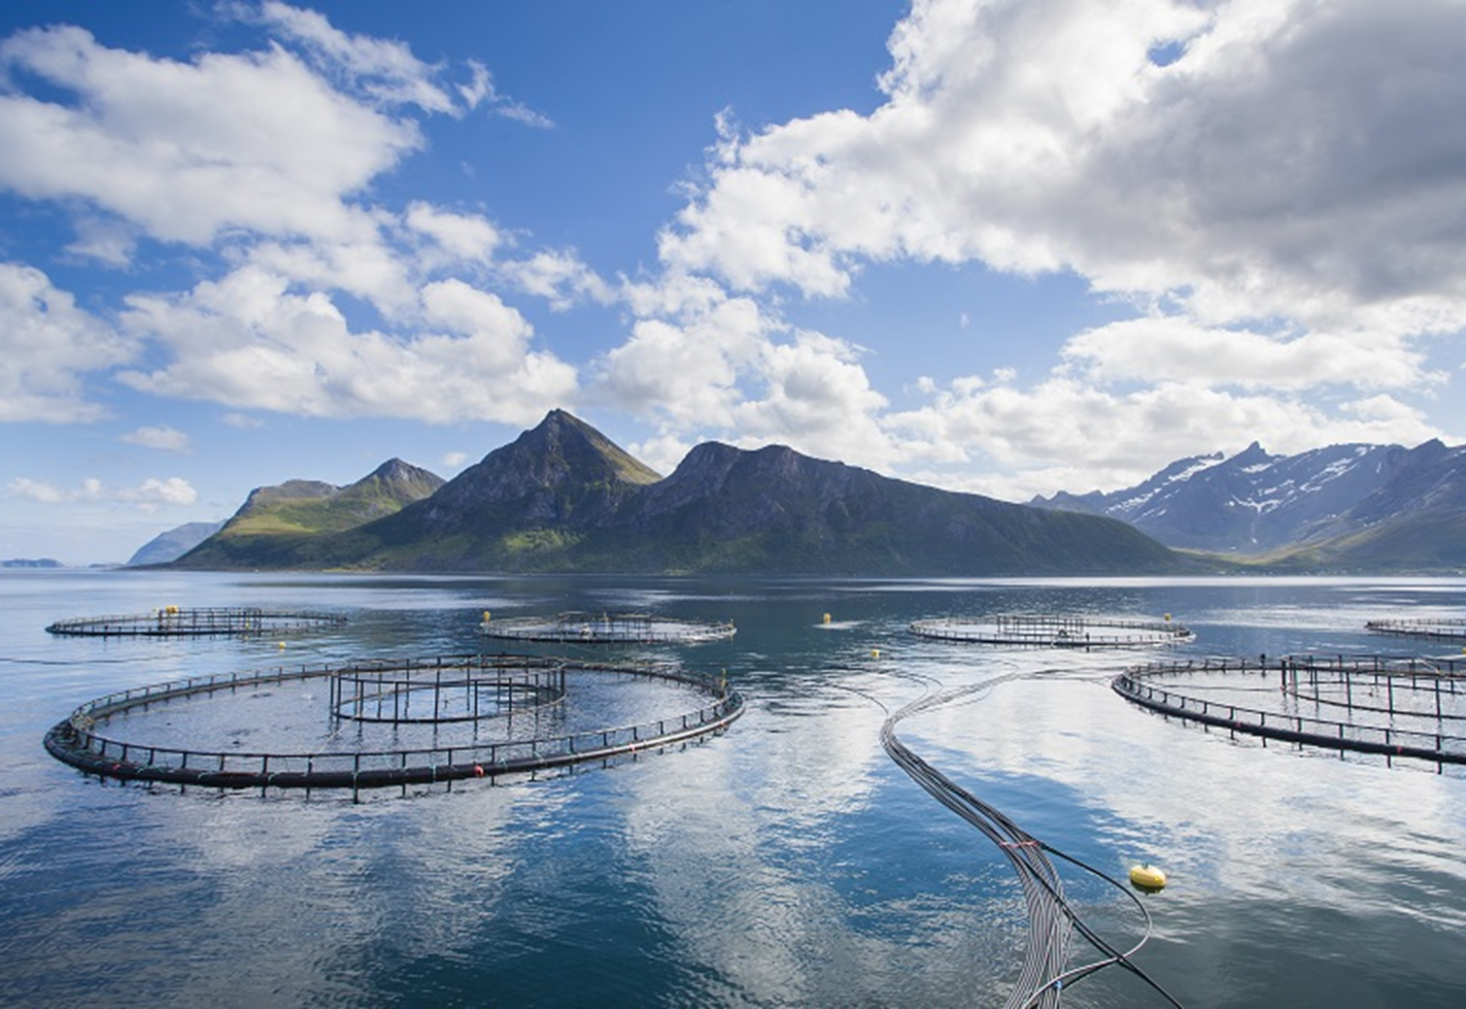
Data collection
Country
Species
Number of animals
Year
Gear type
Outcome
Assessment
Citations
Cross-reference sources – avoid double counting
Photo Credit: Norwegian Seafood Council (NSC)
Additionally searching for:
Reports of no incidents
Documented presence and behavior around aquaculture gear

Slide 9
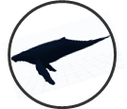
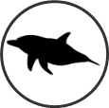
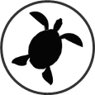
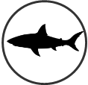
Stressors | Sources | Impacts | Vulnerable species
habitat modification, exclusion, or competition for space | farm construction, operations, and maintenance activities | behavioral change, modified access to foraging and reproduction areas, reduction in fitness, death
physical gear interaction, entanglement, or entrapment | buoy lines, anchor lines, exclusion nets, cage mesh | behavioral change, injury, death
underwater noise | vessels, feeding systems, generators, aerators, net cleaning equipment, acoustic deterrents | behavioral change, trigger stress response, communication disruption, disrupt foraging efficiency, cause habitat displacement or avoidance, temporary or permanent injury, death
artificial light | lights for navigation, personal safety, farm security, submerged lights for fish growth, maturation schedules, reduce fish densities, and evenly distribute fish in cages | behavioral change
presence of vessels | required for construction, operations, and maintenance | vessel collision resulting in injury and/or death, navigation hazard, habitat modification, behavioral change, reduction in fitness
marine debris | rope, nets, buoys, feed bags, plastics, cardboard, wood, rags, tools, syringes, plastic bags, paper waste, oil filters, scrap metal, and general human trash | entanglement or ingestion resulting in sickness, starvation, injury, infection, reduction in fitness, death

Slide 10
Data Summary
Time period | 30+ years
Countries with interactions | 16
Types of aquaculture gear | 11
Total entanglements and entrapments | 407
Number of species (mammals and turtles) | 28
Accidental fatalities | 351

Slide 11
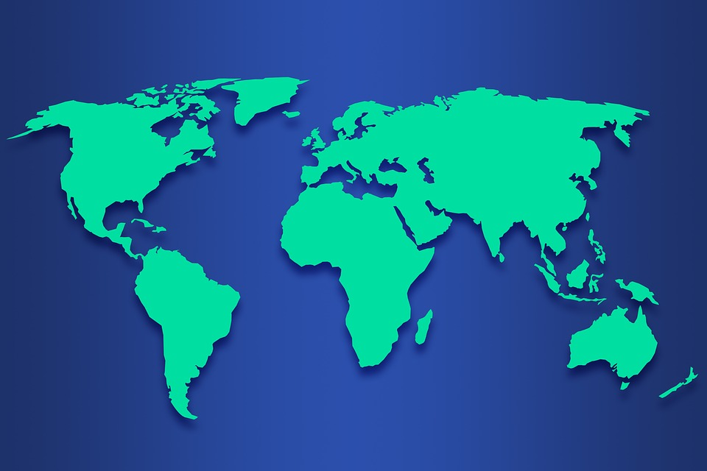
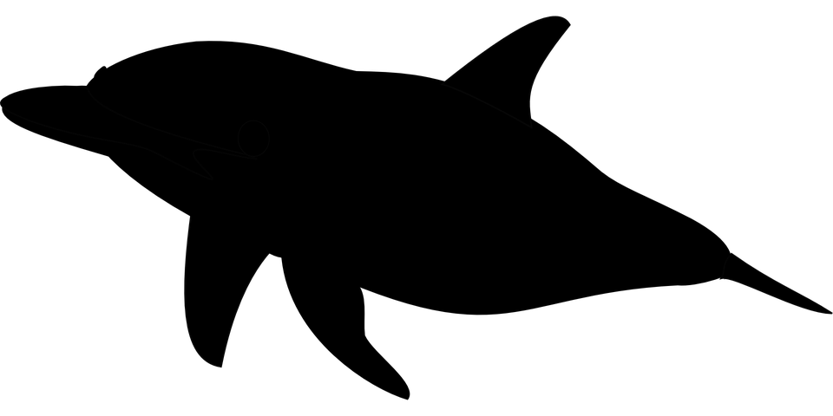
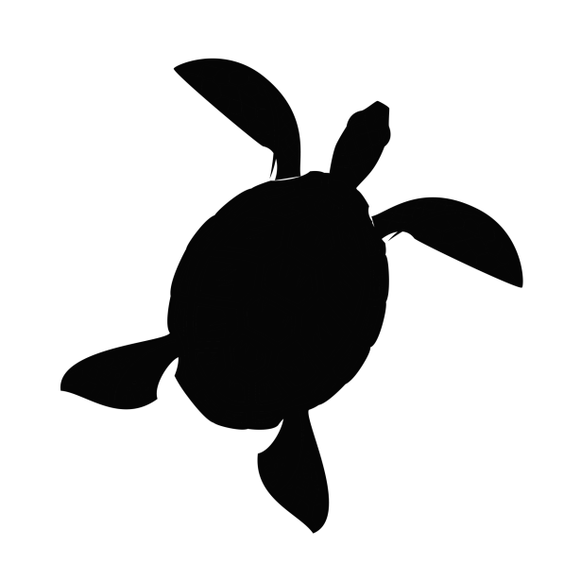
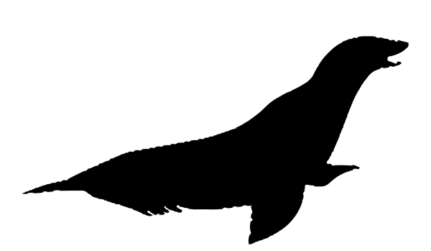
Mussel farm spat lines were the cause of entanglement in all but 1 report
Longline Shellfish Farms
over past 30 years
ICELAND
mussel longline
1998 2010 2012
CANADA
2009 2010 2013
S. KOREA
2015 2019
?
UNITED STATES
2014 2022
PHILIPPINES
whales
dolphins
pinnipeds
NEW ZEALAND
1996 2000 2011
turtles
AUSTRALIA
mortality
ARGENTINA
1998 2004 2008
2011
S. AFRICA
AUSTRALIA
mussel
2019
2005
oyster

Slide 12
Marine Finfish Farms - cetaceans
over past 30 years
whales
NORWAY
dolphins
ICELAND
2005 2015 2018 2009 2014 2015 2019
turtles
2005
CANADA
2013 2016 2016 2016 2016 2007
mortality
x 4
salmon
tuna
other
?
ITALY
2019
x 3
BRUNEI
2003
AUSTRALIA
NEW ZEALAND
1993 1990-1999
1987-2018
CHILE
x 28
x 13
2007 2020 2007 2007-2017
x 6
AUSTRALIA
2008
TASMANIA
1990 1998-2012
x 13

Slide 13
Marine Finfish Farms - pinnipeds
over past 30 years
pinnipeds
SCOTLAND
NORWAY
mortality
(unintentional)
CANADA
x ?
x ?
salmon
2011-2021
tuna
x 92
FAROE ISLANDS
2015-2019
other
x 10
Washington, US
1996-1998
TURKEY
x 41
2019
Hawaii, US
2017
AUSTRALIA
2014-2016
x 2
NEW ZEALAND
200? - 2014
CHILE
x 4
AUSTRALIA
x ?
2014-2016
x 21
TASMANIA
1990’s - 2021
x 128

Slide 14
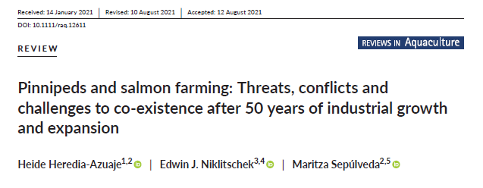

Slide 15
Lessons learned
1. Marine aquaculture poses some level of risk for marine mammals, sea turtles, birds, and sharks.
2. Reported incidents are infrequent and data are seldom quantitative.
3. Data reflecting the lack of interactions are also sparse = no interaction or failure to detect or report?
4. Aquaculture regulation and resource conservation are highly variable across the world.
5. Offshore aquaculture requires advanced technology, sophistication, and significant investment in developed countries.
6. Developed countries generally have established environmental protection policies.
7. Extent of interactions is unknown for countries without regulations, oversight, and accountability.

Slide 16
How do we reduce risk of negative interactions?
Informed siting using innovative spatial analytics
Adaptive monitoring
Use of tension sensors and breakaways on gear
Innovative deterrent technology
Smart design using entanglement simulator technologies

Slide 17
Critical research needs
Animal morphology and interactions with fishing gear
How animals use visual and acoustic senses to detect structures
Quantitative data on properties of mooring lines and cages
Home ranges, movements, behaviors in response to aquaculture farms
Ecosystem shift impacts on species abundance and distribution
Nonlethal effects of disturbance on physiology, behavior
Cumulative effects on individuals and populations

Slide 18
Concluding remarks
This information will be useful for permitting, environmental review,
and consultations
Interactions, potential risks, mitigation strategies, critical research needs
Documentation and improved monitoring protocols
US can learn from decades of innovation by other countries

Slide 19
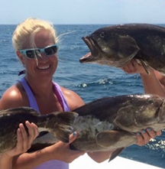
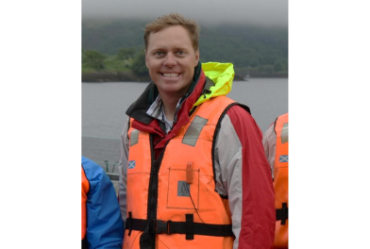
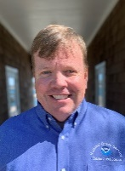
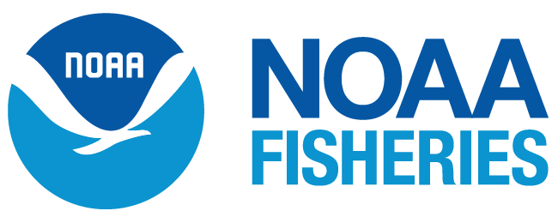
Questions/Discussion
Dr. Gretchen Bath
Dr. James Morris
Dr. Ken Riley
gretchen.bath@noaa.gov
james.morris@noaa.gov
ken.riley@noaa.gov

