Slide 1
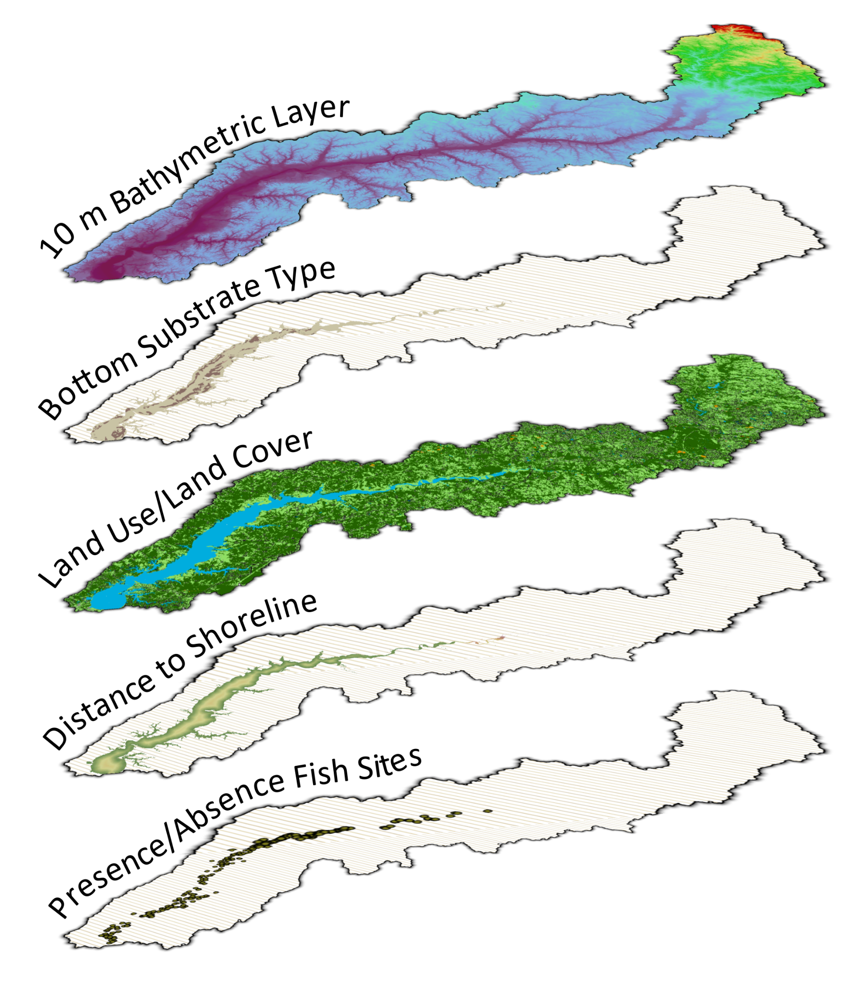
An Integrated Assessment of Fish Habitat for the Patuxent River
How are we accomplishing this?
We are constructing an integrated assessment between headwaters and estuary by overlaying and analyzing a variety of environmental and biological datasets
This joint pilot project will explore and test methods necessary for a fine-scale, management-relevant assessment across both inland and estuarine waters
Why is this important?
The Chesapeake Bay Agreement aims for improved effectiveness of fish habitat conservation and restoration
The Patuxent has undergone significant ecological changes and includes a diverse array of fish barriers and fish habitats in both tidal and non-tidal waters
Who is leading this project?
NOAA’s National Centers for Coastal Ocean Science, Cooperative Oxford Lab
USGS Eastern Ecological Science Center, Leetown Research Lab
What can you do?
Stakeholder input will be important in designing our assessment study
Any insights on fish or shellfish species of interest and other fish habitat issues pertinent to you or your organization are welcomed
Who to Contact
NOAA Contact:
Hannah Nisonson
hannah.nisonson@noaa.gov
USGS Contact:
Stephen Faulkner
faulkners@usgs.gov

